Slide 1
JUNIT FRAMEWORK
Instructor:

Slide 2
Lesson Objectives
After the course, attendees will be able to:
Understand Unit testing and Junit
Know how to write a JUnit test class
Know how to install JUnit and run a JUnit test case
Know about some tips of Unit testing

Slide 3
Table Content
What is Unit Testing?
Introduction to Junit
Setting up JUnit
JUnit Test framework
Junit Assert
Junit TestSuite
Examples

Slide 4
Unit testing
In computer programming, unit testing is a software testing method by which individual units of source code, sets of one or more computer program modules together with associated control data, usage procedures, and operating procedures, are tested to determine whether they are fit for use.
(by wikipedia)
Unit testing, a testing technique using which individual modules are tested to determine if there are any issues by the developer himself. It is concerned with functional correctness of the standalone modules.
The main aim is to isolate each unit of the system to identify, analyze and fix the defects.
(by tutorialspoint)
Notes:
Mục đích chính là cô lập từng đơn vị của hệ thống để xác định, phân tích và sửa chữa các khiếm khuyết.

Slide 5



Unit Test – What and Who ?
Unit Testing Actions:
Validate that individual units of software program are working properly.
A unit is the smallest testable part of an application (In procedural programming a unit may be an individual program, function, procedure, etc., while in object-oriented programming, the smallest unit is always a method)
Unit Testing Deliverables:
Tested software units
Related documents (Unit Test case, Unit Test Report)
Unit Testing Conductor: Development team
Notes:
Kiểm tra đơn vị Actions:
Xác nhận rằng các đơn vị riêng của chương trình phần mềm đang làm việc đúng
Một đơn vị là phần kiểm chứng nhỏ nhất của một ứng dụng (Trong lập trình thủ tục một đơn vị có thể là một chương trình cá nhân, chức năng, thủ tục, vv, trong khi trong lập trình hướng đối tượng, đơn vị nhỏ nhất luôn luôn là một phương pháp)
Các đơn vị được phân biệt với các mô-đun trong mô-đun thường được tạo thành từ các đơn vị
Đơn vị kiểm tra Phân phôi:
Các đơn vị phần mềm thử nghiệm
Tài liệu liên quan (trường hợp Unit Test, Báo cáo thử nghiệm đơn vị)
Chỉ đạo Unit test: nhóm phát triển

Slide 6



Unit Test – Why ?
Ensure quality of software unit.
Detect defects and issues early.
Reduce the Quality Effort & Correction Cost.
Notes:
Đảm bảo chất lượng của đơn vị phần mềm
Phát hiện các khuyết tật và các vấn đề đầu
Giảm nỗ lực & Sửa chữa Chất lượng Chi phí

Slide 7
Introduction to JUnit
Section 2

Slide 8
What is JUnit?
JUnit is an open source framework provided by JUnit.
JUnit enables us to write repeatable tests.
It is mainly used by Java developers to write unit test cases.
The objective of unit testing is to break code into multiple pieces and test each piece of code separately to ensure that it works as it should be.
Integrated nicely with many IDEs, Ant.
Easy to use and to learn.
Version: Junit 3, Junit 4, Junit 5
Notes:
JUnit is an open source framework, developed initially by Erich Gamma and Kent Beck.

Slide 9
Why you need JUnit testing ?
It finds bugs early in the code, which makes our code more reliable.
JUnit is useful for developers, who work in a test-driven environment.
Unit testing forces a developer to read code more than writing.
You develop more readable, reliable and bug-free code which builds confidence during development.
Notes:
confidence : long tin

Slide 10
Features and advantages of JUnit4
All the old assert statements are same as before.
JUnit 4 can be used with Java 5 or higher version.
While using JUnit4, you are not required to extend JUnit.framework.TestCase. You can just create a simple java class.
You need to use annotations in spite of special method name as before.
Most of the things are easier in JUnit4 as.
With JUnit 4 you are more capable of identifying exception.
Parameterized test is introduced, which enables us to use parameters.
JUnit4 still can execute JUnit3 tests.

Slide 11
What is JUnit 5?
Unlike previous versions of JUnit, JUnit 5 is composed of several different modules from three different sub-projects.
JUnit 5 = JUnit Platform + JUnit Jupiter + JUnit Vintage
JUnit Platform: serves as a foundation for launching testing frameworks on the JVM. First-class support for the JUnit Platform also exists in popular IDEs (see IntelliJ IDEA, Eclipse, NetBeans, and Visual Studio Code) and build tools (see Gradle, Maven, and Ant).
JUnit Jupiter:
Blend of new programming model for writing tests and extension model for extensions
Addition of new annotations like @BeforeEach, @AfterEach, @AfterAll, @BeforeAll etc.
JUnit Vintage: provides a TestEngine for running JUnit 3 and JUnit 4 based tests on the platform.

Slide 12
Installation JUnit 5
JUnit 5 requires Java 8 (or higher) at runtime. However, you can still test code that has been compiled with previous versions of the JDK.
JUnit Maven Dependencies
<dependency>
<groupId>org.junit.jupiter</groupId>
<artifactId>junit-jupiter-engine</artifactId>
<version>5.5.2</version>
</dependency>
<dependency>
<groupId>org.junit.platform</groupId>
<artifactId>junit-platform-runner</artifactId>
<version>1.5.2</version>
</dependency>

Slide 13
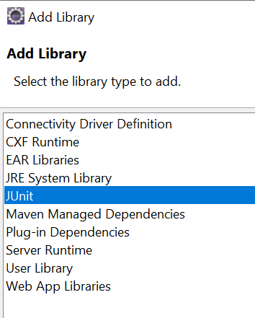
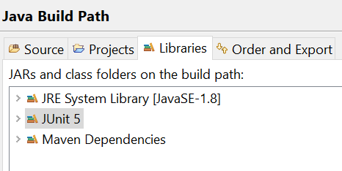
Install JUnit jar file in Eclipse
Add to Libs: R-click to your project | select Java Build Path | click button Add Library | JUnit:
Result:
Eclipse Eclipse IDE offers support for the JUnit Platform since the Eclipse Oxygen.1a (4.7.1a) release.

Slide 14
JUnit Annotations
Listed below are some commonly used annotations provided in it:
Annotation | Description
@Test | Denotes a test method
@DisplayName | Declares a custom display name for the test class or test method
@BeforeEach | Denotes that the annotated method should be executed before each test method
@AfterEach | Denotes that the annotated method should be executed after each test method
@BeforeAll | Denotes that the annotated method should be executed before all test methods
@AfterAll | Denotes that the annotated method should be executed after all test methods
@Disable | Used to disable a test class or test method
@Nested | Denotes that the annotated class is a nested, non-static test class
@Tag | Declare tags for filtering tests
@ExtendWith | Register custom extensions

Slide 15
Junit AssertION
Section 3

Slide 16
Assertion Overview
JUnit 5 assertions help in validating the expected output with actual output of a testcase. To keep things simple, all JUnit Jupiter assertions are static methods in the org.junit.jupiter.Assertions class.
Assertions.assertEquals() and Assertions.assertNotEquals()
Assertions.assertArrayEquals()
Assertions.assertIterableEquals()
Assertions.assertLinesMatch()
Assertions.assertNotNull() and Assertions.assertNull()
Assertions.assertNotSame() and Assertions.assertSame()
Assertions.assertTimeout() and Assertions.assertTimeoutPreemptively()
Assertions.assertTrue() and Assertions.assertFalse()
Assertions.assertThrows()
Assertions.fail()

Slide 17
JUnit Assertion methods
Boolean: If you want to test the boolean conditions (true or false), you can use following assert methods
assertTrue(condition)
assertFalse(condition)
Here the condition is a boolean value.
Null object: If you want to check the initial value of an object/variable, you have the following methods:
assertNull(object)
assertNotNull(object)
Here object is java object e.g. assertNull(actual).

Slide 18
JUnit Assertion methods
Identical: If you want to check whether the objects are identical (i.e. comparing two references to the same java object), or different.
assertSame(expected, actual), It will return true if expected == actual
assertNotSame(expected, actual).
Assert Equals: If you want to test equality of two objects, you have the following methods
assertEquals(expected, actual)
It will return true if: expected.equals( actual ) returns true.

Slide 19
JUnit Assertion methods
Assert Array Equals: If you want to test equality of arrays, you have the following methods as given below:
assertArrayEquals(expected, actual)
Above method must be used if arrays have the same length, for each valid value for i, you can check it as given below:
assertEquals(expected[i],actual[i])
assertArrayEquals(expected[i],actual[i]).
Fail Message: If you want to throw any assertion error, you have fail() that always results in a fail verdict.
Fail(message);
You can have assertion method with an additional String parameter as the first parameter. This string will be appended in the failure message if the assertion fails. E.g. fail( message ) can be written as
assertEquals( message, expected, actual).

Slide 20
JUnit assertEquals
You have assertEquals(a,b) which relies on the equals() method of the Object class.
Here it will be evaluated as a.equals( b ).
If a class does not override the equals() method of Object class, it will get the default behaviour of equals() method, i.e. object identity.
If a and b are primitives such as byte, int, boolean, etc. then the following will be done for assertEquals(a,b) :
a and b will be converted to their equivalent wrapper object type (Byte,Integer, Boolean, etc.), and then a.equals( b ) will be evaluated.
Example:
String obj1="Junit";
String obj2="Junit";
assertEquals(obj1,obj2);
➔ Above assert statement will return true as obj1.equals(obj2) returns true.

Slide 21
Floating point assertions
When you want to compare floating point types (e.g. double or float), you need an additional required parameter delta to avoid problems with round-off errors while doing floating point comparisons.
The assertion evaluates as given below:
Math.abs( expected – actual ) <= delta
For example:
assertEquals( aDoubleValue, anotherDoubleValue, 0.001 )

Slide 22
JUnit Assertion methods
Assertions.assertIterableEquals(): It asserts that expected and actual iterables are deeply equal. Deeply equal means that number and order of elements in collection must be same; as well as iterated elements must be equal.
It also has 3 overloaded methods.
public static void assertIterableEquals(Iterable<?> expected, Iterable> actual)
public static void assertIterableEquals(Iterable<?> expected, Iterable> actual, String message)
public static void assertIterableEquals(Iterable<?> expected, Iterable> actual, Supplier<String> messageSupplier)

Slide 23
JUnit Assertion methods
Example:
@Test
void testCase() {
Iterable<Integer> listOne = new ArrayList<>(Arrays.asList(1, 2, 3, 4));
Iterable<Integer> listTwo = new ArrayList<>(Arrays.asList(1, 2, 3, 4));
Iterable<Integer> listThree = new ArrayList<>(Arrays.asList(1, 2, 3));
Iterable<Integer> listFour = new ArrayList<>(Arrays.asList(1, 2, 4, 3));
// Test will pass
Assertions.assertIterableEquals(listOne, listTwo);
// Test will fail
Assertions.assertIterableEquals(listOne, listThree);
// Test will fail
Assertions.assertIterableEquals(listOne, listFour);
}

Slide 24
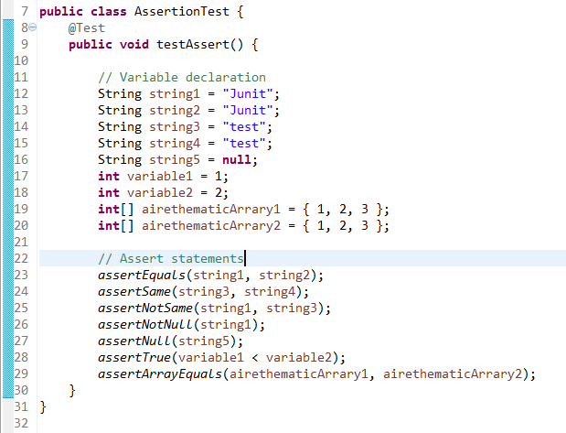
Practical time
Let's create a simple test class named AssertionTest.java.
You will create few variables and important assert statements in JUnit.
Notes:
public class AssertionTest {
@Test
public void testAssert() {
// Variable declaration
String string1 = "Junit";
String string2 = "Junit";
String string3 = "test";
String string4 = "test";
String string5 = null;
int variable1 = 1;
int variable2 = 2;
int[] airethematicArrary1 = { 1, 2, 3 };
int[] airethematicArrary2 = { 1, 2, 3 };
// Assert statements
assertEquals(string1, string2);
assertSame(string3, string4);
assertNotSame(string1, string3);
assertNotNull(string1);
assertNull(string5);
assertTrue(variable1 < variable2);
assertArrayEquals(airethematicArrary1, airethematicArrary2);
}
}

Slide 25
JUnit 5 Test LifeCycle
Section 4

Slide 26
Before And After
In JUnit 5, test lifecycle is driven by 4 primary annotations i.e. @BeforeAll, @BeforeEach, @AfterEach and @AfterAll.
Along with it, each test method must be marked with @Test annotation. @Test annotation is virtually unchanged, although it no longer takes optional arguments.
Why?
You will primarily need to have some methods to setup and tear down the environment or test data on which the tests run.
@BeforeAll and @AfterAll annotations should be called only once in entire tests execution cycle. So they must be declared static.
@BeforeEach and @AfterEach are invoked for each instance of test so they need not to be static.
Notes:
If their are multiple methods annotated with same annotation (e.g. two methods with @BeforeAll) then their execution order is undetermined.

Slide 27
Writing Tests in JUnit 5
package fa.training.jpe;
import org.junit.jupiter.api.AfterAll;
import org.junit.jupiter.api.AfterEach;
import org.junit.jupiter.api.Assertions;
import org.junit.jupiter.api.BeforeAll;
import org.junit.jupiter.api.BeforeEach;
import org.junit.jupiter.api.Disabled;
import org.junit.jupiter.api.Tag;
import org.junit.jupiter.api.Test;
/**
* Unit test for simple App.
*/
public class AppTest {
@BeforeAll
static void setup() {
System.out.println("@BeforeAll executed");
}
@BeforeEach
void setupThis() {
System.out.println("@BeforeEach executed");
}
@Tag("DEV")
@Test
void testCalcOne() {
System.out.println("======TEST ONE EXECUTED=======");
Assertions.assertEquals(4, Calculator.add(2, 2));
}
@Tag("PROD")
@Disabled
@org.junit.jupiter.api.Test
void testCalcTwo() {
System.out.println("======TEST TWO
EXECUTED=======");
Assertions.assertEquals(6,
Calculator.add(2, 4));
}
@AfterEach
void tearThis() {
System.out.println("@AfterEach executed");
}
@AfterAll
static void tear() {
System.out.println("@AfterAll executed");
}
}

Slide 28
Writing Tests in JUnit 5
Where Calculator class is:
package fa.training.jpe;
public class Calculator {
public static int add(int a, int b) {
return (a + b);
}
}

Slide 29
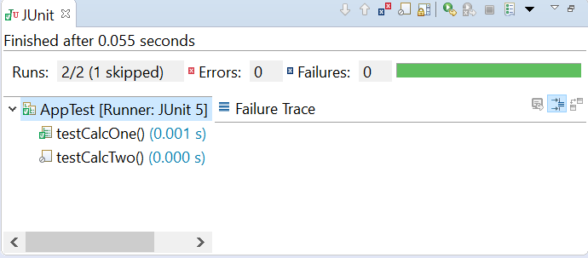
Writing Tests in JUnit 5
Result Execute:
Console Output:
@BeforeAll executed
@BeforeEach executed
======TEST ONE EXECUTED=======
@AfterEach executed
@AfterAll executed

Slide 30
Disabling Test
To disable a test in JUnit 5, you will need to use @Disabled annotation.
@Disabled annotation can be applied over test class (disables all test methods in that class) or individual test methods as well.
@Disabled
@Test
void testCalcTwo() {
System.out.println("======TEST TWO EXECUTED=======");
Assertions.assertEquals( 6 , Calculator.add(2, 4));
}

Slide 31
@BeforeEach and @AfterEach annotations
The @BeforeEach is used to signal that the annotated method should be executed before each @Test method in the current class.
The @AfterEach is used to signal that the annotated method should be executed after each @Test method in the current class.
@BeforeEach and @AfterEach annotated methods MUST NOT be a static method otherwise it will throw runtime error.
Example:
package fa.training.jpe;
import org.junit.jupiter.api.Assertions;
import org.junit.jupiter.api.BeforeAll;
import org.junit.jupiter.api.BeforeEach;
import org.junit.jupiter.api.Test;
class BeforeEachTest {
@Test
void addNumber() {
System.out.println("Running test -> 1");
Assertions.assertEquals(2, Calculator.add(1, 1), "1 + 1 should equal 2");
}

Slide 32
@BeforeEach and @AfterEach annotations
Example:
@Test
void addNumber2() {
System.out.println("Running test -> 2");
Assertions.assertEquals(2, Calculator.add(1, 1), "1 + 1 should equal 2");
}
@Test
void addNumber3() {
System.out.println("Running test -> 3");
Assertions.assertEquals(2, Calculator.add(1, 1), "1 + 1 should equal 2");
}
@BeforeAll
public static void init() {
System.out.println("BeforeAll init() method called");
}
@BeforeEach
public void initEach() {
System.out.println("BeforeEach initEach() method called");
}
@AfterEach
public void cleanUpEach() {
System.out.println("After Each cleanUpEach() method called");
}
@AfterAll
public static void cleanUp() {
System.out.println("After All cleanUp() method called");
}
}

Slide 33
@BeforeEach and @AfterEach annotations
Console Output:
BeforeAll init() method called
BeforeEach initEach() method called
Running test -> 1
After Each cleanUpEach() method called
BeforeEach initEach() method called
Running test -> 2
After Each cleanUpEach() method called
BeforeEach initEach() method called
Running test -> 3
After Each cleanUpEach() method called
After All cleanUp() method called

Slide 34
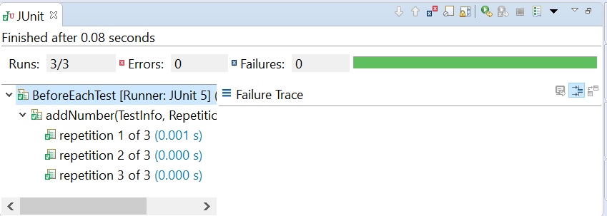
@RepeatedTest Annotation
JUnit 5 @RepeatedTest annotation enable to write repeatable test templates which could be run multiple times.
Example:
Result:
@RepeatedTest(3)
void addNumber(TestInfo testInfo, RepetitionInfo repetitionInfo) {
System.out
.println("Running test -> " + repetitionInfo.getCurrentRepetition());
Assertions.assertEquals(2, Calculator.add(1, 1), "1 + 1 should equal 2");
}

Slide 35
Junit 5 Test Suite
Section 5

Slide 36
Test Suite Overview
Using JUnit 5 test suites, you can run tests spread into multiple test classes and different packages.
JUnit 5 provides two annotations: @SelectPackages and @SelectClasses to create test suites. Additionally, you can use other annotations for filtering test packages, classes or even test methods.
@SelectClasses specifies the classes to select when running a test suite
@SelectPackages specifies the names of packages to select when running a test suite
As we learn that @SelectPackages causes all it’s sub-packages as well to be scanned for test classes.
If you want to exclude any specific sub-package, or include any package then you may use @IncludePackages and @ExcludePackages annotations.

Slide 37
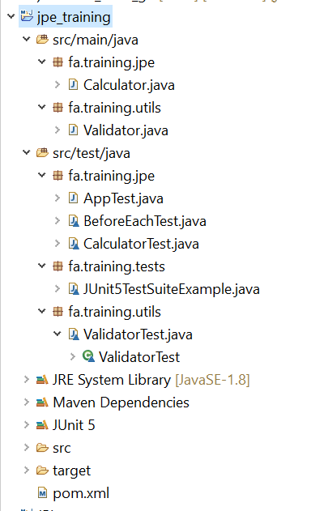
Test Suite Example
Project Structure:
package fa.training.tests;
import org.junit.platform.runner.JUnitPlatform;
import org.junit.platform.suite.api.SelectPackages;
import org.junit.runner.RunWith;
@RunWith(JUnitPlatform.class)
@SelectPackages({ "fa.training.jpe", "fa.training.utils" })
class JUnit5TestSuiteExample {
}
Notes:
package fa.training.utils;
import java.util.regex.Pattern;
public class Validator {
/**
* Check bill code follow the pattern.
*
* @method isValidBillCode
* @param billCode
* @return true if bill code is valid, else false
*/
public static boolean isValidBillCode(String billCode) {
return Pattern.matches("^(B)[0-9]{4}$", billCode);
}
}

Slide 38
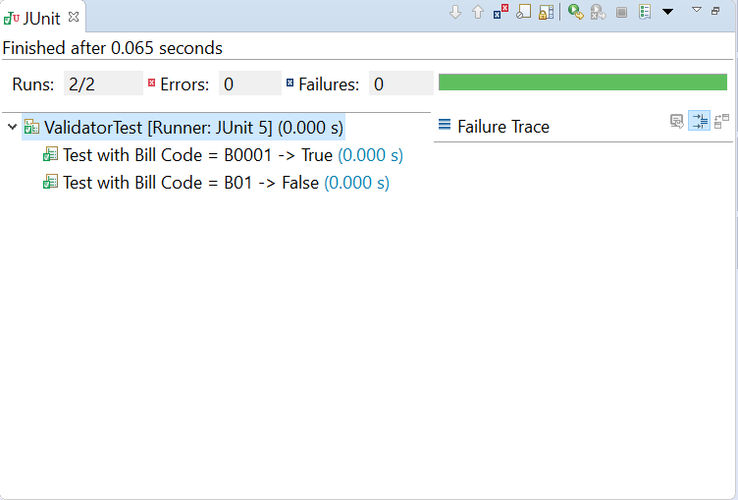

Slide 39
Test Result
A test method in a test case can have one of three results:
Pass – all assertions matched expected values
Failed – an assertion did not match expected value
Error – an unexpected exception was thrown during execution of test method

Slide 40
JUnit Exception Test
JUnit provides the facility to trace the exception and also to check whether the code is throwing expected exception or not.
Junit4 provides an easy and readable way for exception testing, you can use:
Optional parameter (expected) of @test annotation and
To trace the information ,"fail()" can be used.

Slide 41
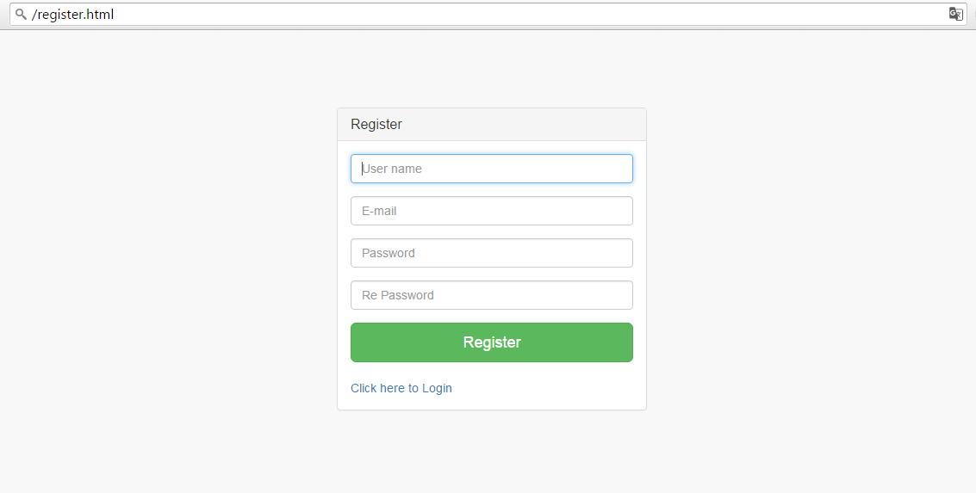
Practical time
Let’s create unit test class on DAO layer of below screen:

Slide 42
Resources & References
Resources
www.junit.org/
http://junit.sourceforge.net
Recommended readings
Manning – Junit in Action
Test Driven Development: By Example. Boston: Addison-Wesley, 2003

Slide 43
Summary
Introduction to Junit
Setting up JUnit
JUnit Test framework
Junit Assert
Junit TestSuite
Examples

Slide 44

Thank you
44

